Slide 1
Basic Computing Curriculum
Session 4: Customizing Microsoft Windows
Notes:
Microsoft Windows provides users with a wide range of customization options to personalize their desktop and system settings. In this presentation, we will explore the basics of customizing Microsoft Windows to suit your preferences.

Slide 2
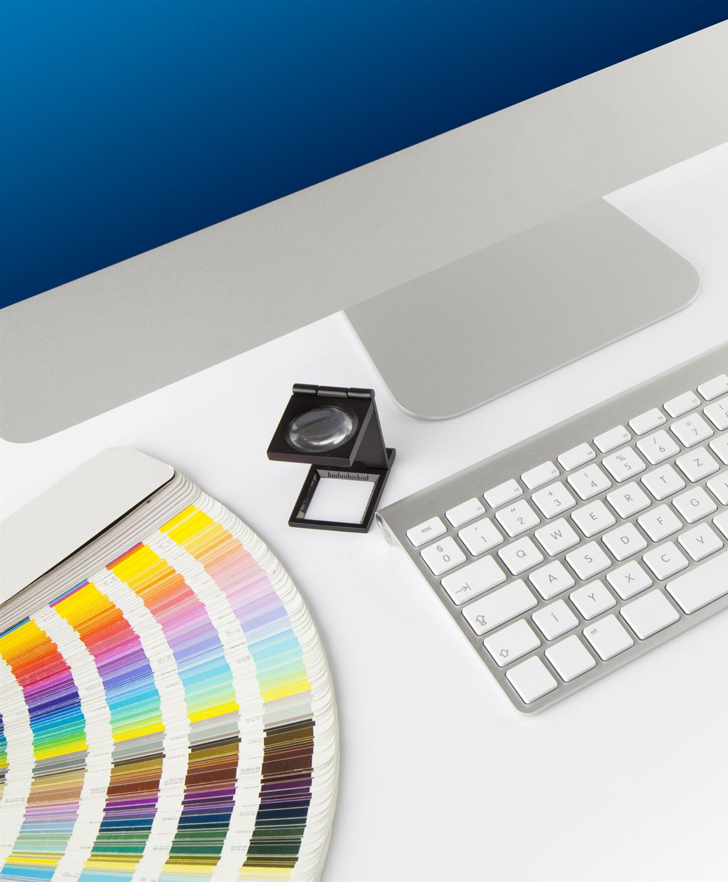
Presentation Overview
Customizing the Desktop
  Customizing the desktop is essential to personalize your computer. This includes changing the background and customizing the taskbar to make it more user-friendly.
Personalization
  Personalization involves changing themes and lock screen settings. This helps to create a unique experience for each user.
System Settings
  System settings are important for optimizing the performance of your computer. We will cover display settings, power and sleep settings, and more.
Notes:
We will start by exploring the basics of customizing the desktop, including changing the background and customizing the taskbar. Then, we will delve into personalization, covering topics such as changing themes and lock screen settings. Finally, we will cover some key system settings, including display settings and power and sleep settings.

Slide 3

Customizing Desktop
Change Desktop Background
  Changing the desktop background is easy and a great way to personalize your computer. You can choose from a variety of pre-installed images or add your own.
Add Shortcuts to the Taskbar
  Adding shortcuts to the taskbar is a great way to quickly access your favorite applications. You can add or remove shortcuts, and rearrange them as per your preference.
Customize Taskbar Settings
  Customizing taskbar settings can improve your productivity. You can choose to hide or show taskbar icons, change the color and transparency, and even auto-hide the taskbar.
Notes:
Customizing the desktop is a great way to personalize your Windows experience. We will explore how to change the desktop background, add shortcuts to the taskbar, and customize the taskbar settings.

Slide 4

Changing Desktop Background
  Windows allows you to customize your desktop background by using your own images, choosing from the available Windows themes, and adjusting the image position.
Notes:
The desktop background is the first thing you see when you start up Windows. We will explore how to change the background to suit your preferences, including using your own images, choosing from the available Windows themes, and adjusting the image position.

Slide 5
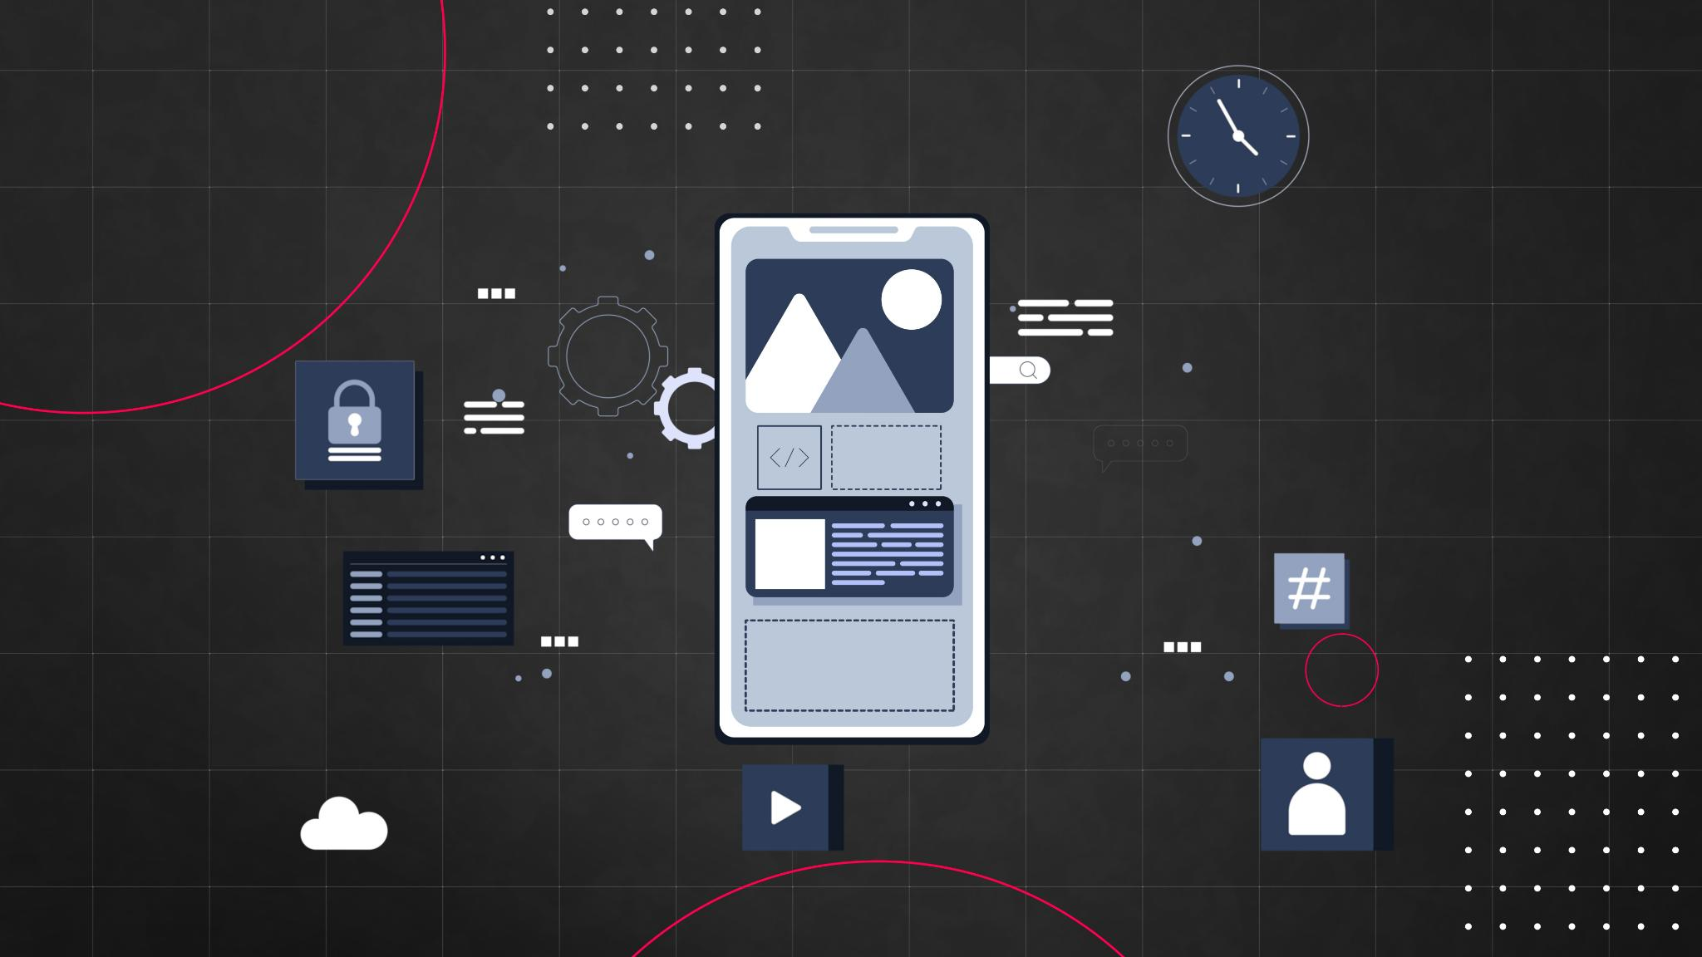
Customizing Taskbar
Pinning and Unpinning Apps
  You can easily pin and unpin apps to the taskbar to customize your desktop. This allows you to quickly access your favorite apps without having to search for them.
Rearranging Icons
  You can also rearrange icons on the taskbar to suit your needs. This allows you to organize your apps and settings in a way that makes sense to you.
Adjusting Taskbar Settings
  You can adjust the taskbar settings to customize the appearance and functionality of the taskbar. This includes changing the taskbar location, size, and color, as well as enabling or disabling taskbar features.
Notes:
The taskbar is an essential part of the Windows desktop, providing quick access to your favorite apps and system settings. We will explore how to customize the taskbar, including pinning and unpinning apps, rearranging icons, and adjusting the taskbar settings.

Slide 6

Personalization
Change Themes
  Windows provides a range of themes that can be customized to suit your preferences. You can change your theme, wallpaper, and screensaver to personalize your desktop.
Adjust Lock Screen Settings
  You can customize your lock screen settings by selecting a background image, changing the time format, or displaying quick status updates.
Customize Windows Colors and Appearance
  You can customize the colors and appearance of Windows by changing the font size, scaling, and accent colors. You can also customize settings for the taskbar, Start menu, and Action Center.
Notes:
Personalization allows you to make Windows your own. We will explore how to change themes, adjust lock screen settings, and customize the colors and appearance of Windows.

Slide 7

Changing Themes
Changing Themes
  Windows 10 comes with a range of pre-installed themes that you can choose from. This keyPoint will cover how to change themes in Windows 10.
Adjusting Accent Colors
  In Windows 10, accent colors are used to highlight certain parts of the user interface, such as buttons and links. This keyPoint will cover how to adjust accent colors in Windows 10.
Enabling Dark Mode
  Dark mode is a popular feature in modern operating systems, as it reduces eye strain and looks better in low-light situations. This keyPoint will cover how to enable dark mode in Windows 10.
Notes:
Windows comes with a range of pre-installed themes that you can choose from. We will explore how to change themes, including using custom themes, adjusting accent colors, and enabling dark mode.

Slide 8

Lock Screen Settings
Customize Background Image
  You can customize the lock screen background image by selecting a picture from your device or choosing one of the pre-installed images.
Enable or Disable Slide Show
  You can enable or disable the slide show feature on the lock screen, which will display a series of images as a slideshow.
Choose Apps on Lock Screen
  You can choose what apps to show on the lock screen, such as email, calendar, and weather, to get quick access to important information.
Notes:
The lock screen is the first thing you see when you start up or wake up your Windows device. We will explore how to customize the lock screen, including changing the background image, enabling or disabling slide show, and choosing what apps to show on the lock screen.

Slide 9

System Settings
Display Settings
  Windows provides various display settings which can be customized to suit your preferences. Screen resolution, brightness, and orientation are some of the key display settings that can be adjusted.
Power and Sleep Settings
  Power and sleep settings allow users to adjust their computer's power usage and sleep mode. These settings help conserve energy and extend battery life.
Other Key System Settings
  Windows provides various other system settings that can be customized to suit your preferences. These settings include language preferences, time and date settings, and more.
Notes:
Windows provides a range of system settings that can be customized to suit your preferences. We will explore how to adjust display settings, power and sleep settings, and other key system settings.

Slide 10

Display Settings
Screen Resolution
  Screen resolution determines the number of pixels displayed on your screen, affecting the sharpness and clarity of images and text. Windows allows you to adjust your screen resolution to suit your preferences and the capabilities of your display.
Scaling
  Scaling allows you to adjust the size of text, apps, and other items on your screen, making them easier to read and use. Windows allows you to adjust scaling settings to suit your preferences and the capabilities of your display.
Orientation
  Orientation determines the alignment of your screen, either in portrait or landscape mode. Windows allows you to adjust the orientation settings to suit your preferences and the capabilities of your display.
Notes:
Windows allows you to adjust the display settings to suit your preferences, including choosing the screen resolution, scaling, and orientation. We will explore how to adjust these settings and customize the appearance of your Windows device.

Slide 11

Power and Sleep Settings
Screen Timeout
  Windows power settings allow you to adjust the screen timeout to conserve battery life. This helps to optimize power consumption and can extend the life of your device.
Brightness Settings
  Windows power and sleep settings allow you to adjust the brightness of your device's screen. This can help to conserve battery life and reduce eye strain.
Managing Battery Settings
  Windows power and sleep settings allow you to manage battery settings, including battery saver mode, battery usage by app, and battery percentage. This can help you optimize your device's battery life and performance.
Notes:
Windows provides power and sleep settings that allow you to balance performance and battery life. We will explore how to adjust these settings, including setting the screen timeout, adjusting the brightness, and managing battery settings.

Slide 12

Conclusion
  Customizing Windows can help make your device more personal and allow you to work more efficiently. In this presentation, we have explored the basics of customizing the desktop, personalization, and system settings. We hope that this has provided you with a great starting point to explore all the customization options that Windows has to offer.
Notes:
Customizing Windows can help make your device more personal and allow you to work more efficiently. In this presentation, we have explored the basics of customizing the desktop, personalization, and system settings. We hope that this has provided you with a great starting point to explore all the customization options that Windows has to offer.

